Slide 1


Header
Microsoft Virtual Academy
Mastering Node.js, Part 1
Introduction to Node.js
Eric W. Greene
Produced by

Slide 2
Course Overview
What is Node.js?
Installing Node.js
Node REPL
Node Programs
Managing Packages with NPM
Building a Simple Web Server
Reading Files from Disk
Debugging
Creating a Package
Use NPM to run a package

Slide 3
What is Node.js?
Node.js is a cross-platform, JavaScript environment on the server
JavaScript is a glue language for C++ modules
It is powered by Google’s V8 JavaScript engine
Node.js uses an event driven, non-blocking I/O model
Node.js is like a web browser with a different set of C++ modules
It provides modules for interacting with local system resources such as processes, file system, networking, etc…

Slide 4
Node.js compared to a Web Browser
Web Browser
Node.js
Web Sockets
DOM
XHR
Process
File System
Net
File Reader
JavaScript
V8
Audio
HTTP
JavaScript
V8
Cluster
Timers
Video
Many More…
Timer
Stream
Many More…

Slide 5
Installing Node.js
Node.js can be installed from a platform specific installer, precompiled source code, and compiled from source code
To download the installer: http://www.nodejs.org
When installing using the platform specific installer, most users accept the defaults

Slide 6
Node.js Versions
The installer and pre-compiled binaries can be downloaded for either the Long-Term Support version or Current Version
Long-Term Support version is best for applications in production
The Current Version is best for working with the newest features

Slide 7
Installing Node.js

Slide 8
Node REPL Environment
REPL stands for Read, Evaluate, Print, Loop
Allows the user to enter a JavaScript command, evaluate it, print the results, and loop to enter another command
Supports multiline commands, customize command prompt and preconfigured context
Sessions can be saved, and reloaded again
Useful for learning JavaScript or executing tasks from a JavaScript command line

Slide 9
Using the Node REPL Environment

Slide 10
Node.js Programs
Node.js programs can be created using JavaScript files which are executed with the Node.js executable
JavaScript files contain JavaScript programming statements and expressions, and have a filename extension of ‘.js’
To execute a Node.js program, run the Node.js executable for the given environment and pass the name of the file (with or without the JS extension) as the first argument

Slide 11
Running Node.js Program

Slide 12
Managing Packages with NPM
NPM is an acronym for Node.js Package Manager
NPM provides a public package repository, a specification for building packages, and a command line tool for working with packages
http://www.npmjs.com
The company npm, Inc. develops and maintains NPM
Node.js distributes the npm executable along with the node executable, but it's actually a separate program with its own versioning

Slide 13
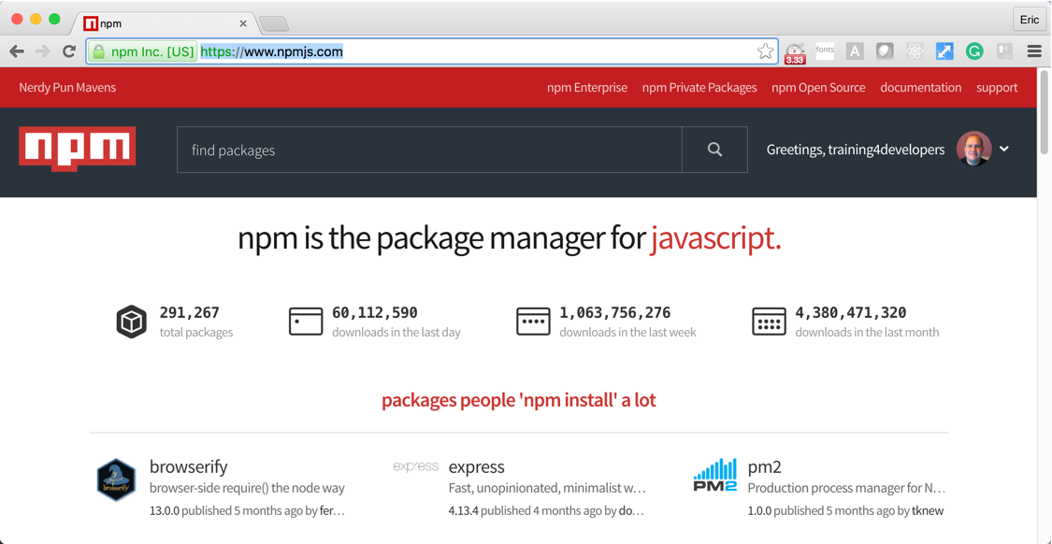
NPM Public Repository
https://www.npmjs.com/

Slide 14
Local vs Global Packages
Packages can be installed locally or globally
Local packages are stored locally in a project, in the node_modules folder
Global packages are stored globally on system
Typically, local packages are code libraries used by project
Typically, global packages are executables used to perform some operation on a project such as running tasks
Local packages are available only within their specific project, and global packages are available system wide

Slide 15
Installing & Uninstalling Packages
The npm program is used to manage packages
The first argument to the npm program is the command to be executed
Packages can be installed with the install command, and uninstalled with the uninstall command
There are many more commands available for NPM
The –global flag installs and uninstalls the package globally, without the global flag, the packages are installed and uninstalled locally

Slide 16
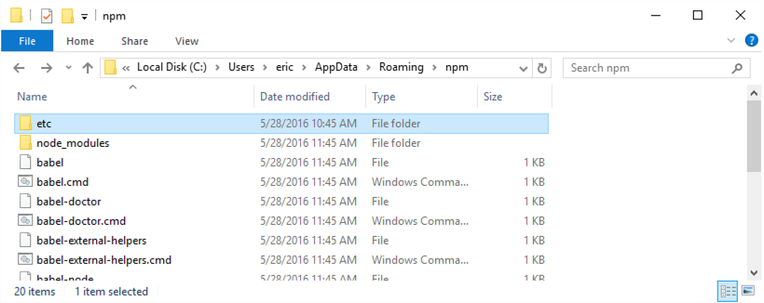
Global Packages on Windows
Are global to the user, not the system
Does not require administrative privileges
Globally Installed Packages are stored in:
C:\Users\<username>\AppData\Roaming\npm

Slide 17
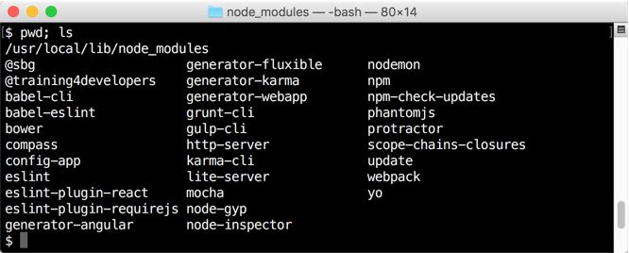
Global Packages on Mac and Linux
By default, are global to the system, not just the user
Requires administrative privileges, unless permissions are fixed
On a Mac by default, Globally Installed Packages are stored in:
/usr/local/lib/node_modules

Slide 18
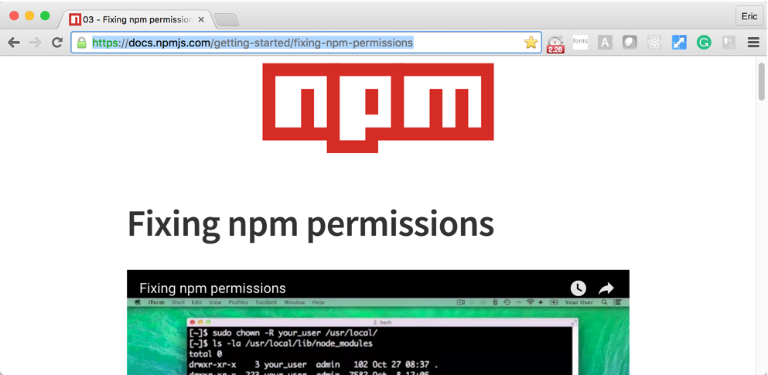
Fixing Permissions for Global Packages
https://docs.npmjs.com/getting-started/fixing-npm-permissions

Slide 19
Managing Packages with NPM

Slide 20
Building a Simple Web Server
One of the core modules for Node.js is the HTTP module, which provides a web server and web client
The web server is very flexible, but requires a lot of boiler plate coding to build even the simplest applications
Commonly, other packages such as Express or Hapi are used to configure the web server
Web server are I/O intensive applications making them well suited for Node.js
Node.js is great for web servers because of its easy handling of JSON data

Slide 21
Building a Simple Web Server

Slide 22
Reading Files from Disk
Node.js allows full access to the system (such as accessing the file system), unlike a web browser which only allows sandboxed access
Accessing file system resources can be synchronously and asynchronously
Synchronous access can be used for initial program loading, but only asynchronous access should be used during program operation
Both text and binary data can read and written
Full support for streams

Slide 23
Reading Files from Disk

Slide 24
Debugging Node.js
Node.js comes with a built in command line debugger, but its limited
Instead, there are many code editors and other tools which greatly simplify debugging of Node.js applications
StrongLoop's Node Inspector (free – Windows/Mac/Linux)
Microsoft Visual Studio Code (free – Windows/Mac/Linux)
Microsoft Visual Studio with Node.js Extension (community edition free – Windows only)
GitHub's Atom with Node Debugger Package (free – Windows/Mac/Linux)
JetBrains' WebStorm (not free – Windows/Mac/Linux)
These IDEs provide the standard fare of debugging tools such as breakpoint, call stacks, watches, and local variables

Slide 25
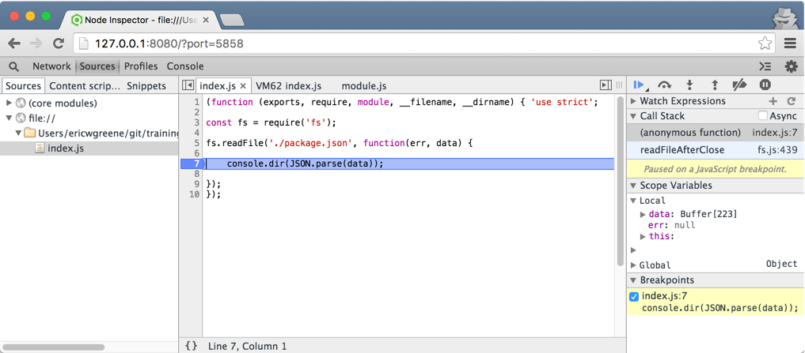
StrongLoop's Node Inspector
https://github.com/node-inspector/node-inspector

Slide 26
Debugging Node.js using Node Inspector

Slide 27
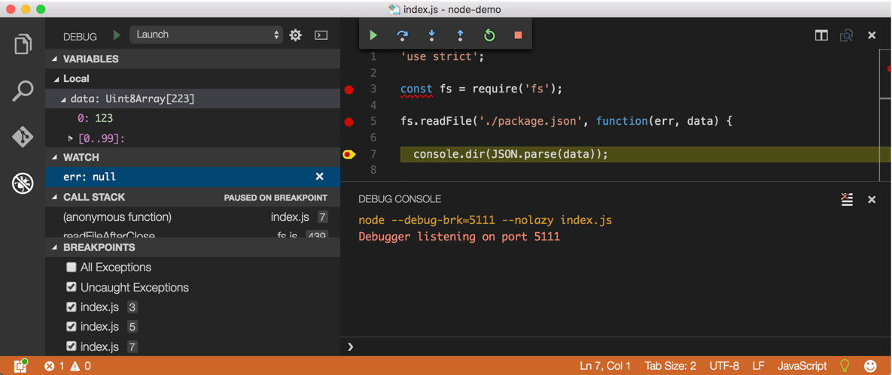
Microsoft's Visual Studio Code
https://code.visualstudio.com

Slide 28
Debugging Node.js using Visual Studio Code

Slide 29
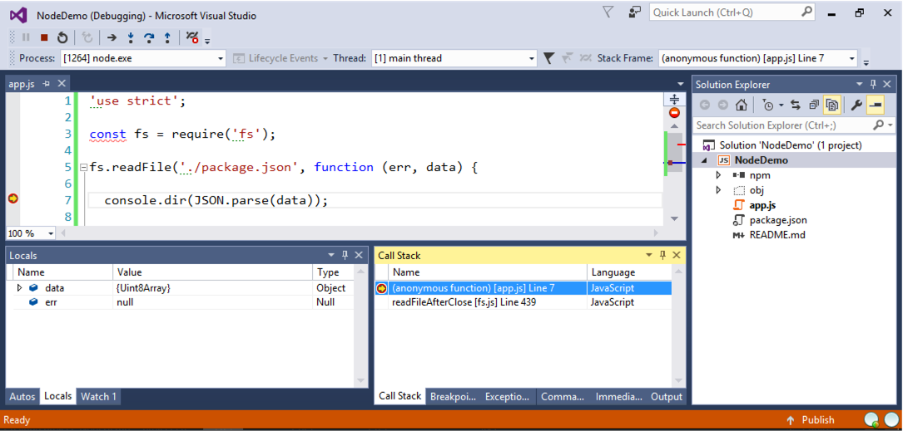
Microsoft's Visual Studio with Node.js Extension
https://www.visualstudio.com/products/visual-studio-community-vs

Slide 30
Debugging Node.js using Visual Studio with Node Extension

Slide 31
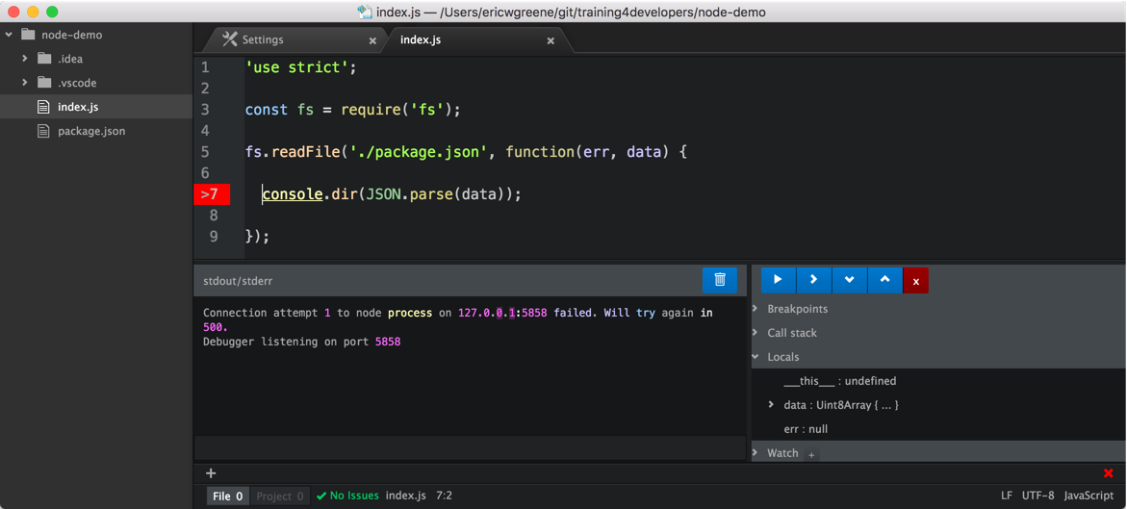
GitHub's Atom with the Node Debugger Package
https://atom.io

Slide 32
Debugging Node.js using Atom with Node Debugger Package

Slide 33
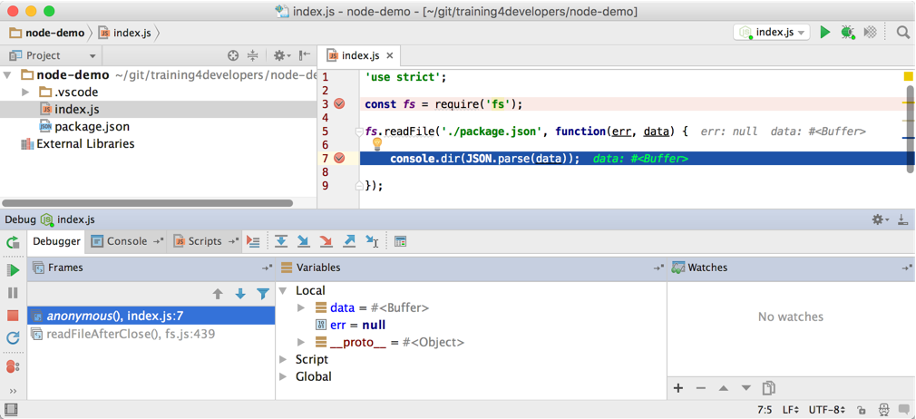
JetBrains' WebStorm
https://www.jetbrains.com/webstorm

Slide 34
Debugging Node.js using WebStorm

Slide 35
Creating a Package
All projects (which are also packages) need to be configured to work with NPM
The command npm init is used to configure a project
It will ask a series of questions, all of which have default answers, that are used to create and initialize a package.json file
The package.json file contains metadata about the project, as well as, a list of application and development dependencies
When NPM packages are installed, NPM will register them with the package.json file

Slide 36
Saving Package Dependencies
Simply installing packages do not save the dependency in the package.json file
In addition to installing, additional flags need to be specified:
--save or -S will save the package as an application dependency
--save-dev or -D will save the package a development dependency
Application dependencies are used by the Node.js program when executing (common example would be Express)
Development dependencies are used to develop the Node.js program (common example would be Grunt)

Slide 37
Saving Package Dependencies
The terminal commands to left, will produce a package.json file similar to the one on the right.
The file is a JSON file, and can be edited by hand
Name is the name of the package
Version follows the SEMVER scheme
The version of each dependency is tracked as well
Main is the main file imported when requiring the module
Terminal Commands
Package.json

Slide 38
Creating a Package

Slide 39
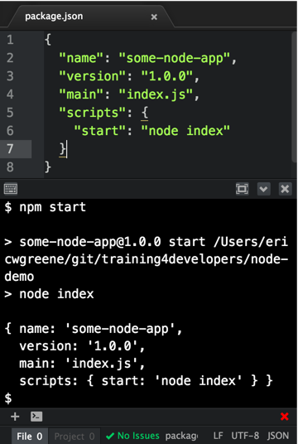
Use NPM to run a package
In addition to managing packages with NPM, packages can be configured to be executed with NPM
To configure the execution of Node packages, the scripts option of the package.json is configured
To run a Node.js program, the start script is configured

Slide 40
Use NPM to run a package

Slide 41
Conclusion
Node.js is a great platform building applications, especially applications which are I/O intensive
Working with Node.js involves many tools for managing packages, debugging code, and packaging projects for deployment
The Node Package Manager (NPM) is used to install packages, and divide applications into smaller reusable parts
Node.js can be used for development tooling, web applications and general purpose applications

